Slide 1
A Level Computer Science AQA 7516/1
C# Programming 1 – Data Types and Variables

Slide 2
Key Vocabulary
Algorithm
Program
Syntax
Compilation
Run-time
Declaration
Variable
Assign
Annotate
Type
Range
Convert
Initialise
Constant

Slide 3
Algorithms and Programs
Algorithm
An ordered sequence of steps that can be followed to complete a task and that always terminates. This is independent of a programming language
Program
A specific implementation of an algorithm in a computer programming language. A sequence of instructions.
Notes:
Algorithm communicates computation to humans not computers.

Slide 4
Ambiguity
Actual Newspaper Headlines:
Miners refuse to work after death
Drunk gets nine months in violin case
Survivor of Siamese twins joins parents
Sisters reunited after 18 years at checkout counter
Safety experts say school bus passengers should be belted
Panda mating fails, Vet takes over

Slide 5

Syntax
Whats wrong with this question?
Syntax rules eliminate ambiguity – the stricter the better!
C# is a strongly-typed language – explicit casting is required.
The use of an apostrophe is an English language rule.
Programming language rules are called syntax

Slide 6
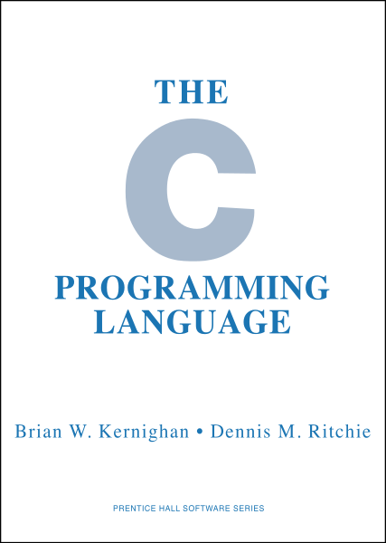
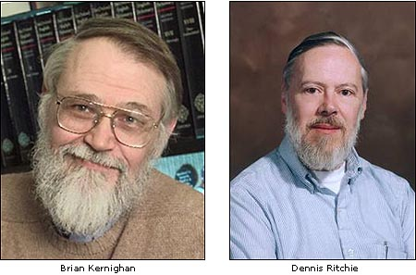
One language to rule them all!
The C Programming Language was developed by Brian Kernighan and Dennis Ritchie in 1969.
“C is not a big language and is not best served by a big book.”
Which operating system was famously built using C?

Slide 7

Philosophical consideration…
What came first,
C
or
the C compiler?

Slide 8
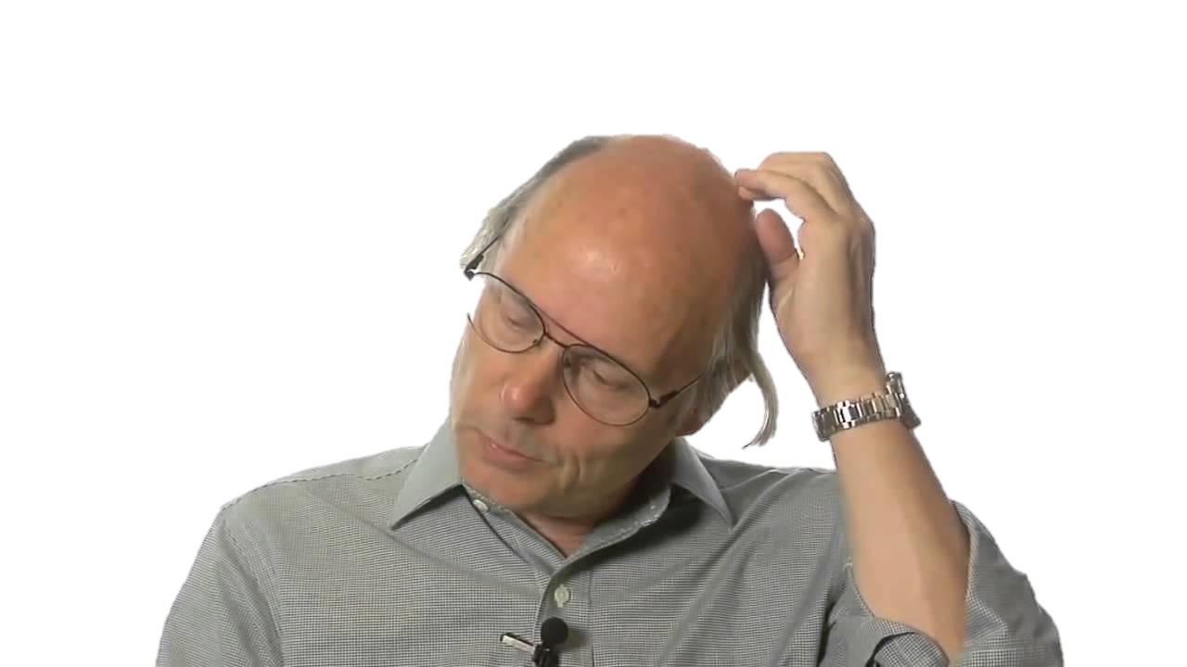
The origin of C#
The C++ Programming Language was developed by Bjarne Stroustrup in 1983.
Java was developed by Sun Microsystems (James Gosling) in 1994.
C# was developed by Microsoft in 2000 taking influences from both C++ and Java.
Bjarne says:
"C makes it easy to shoot yourself in the foot;
C++ makes it harder, but when you do, it blows off your whole leg!"
Notes:
Applications written in C++ include Apple’s OS X and most Adobe software.
C and C++ closely matches machine code.
Java is not great for real-time applications.
C# was developed by MS for technical, political and marketing reasons.

Slide 9
Program 1A – Hello World
You are going to write your first ever program using a high level language called C#
Write a program to display ‘Hello world!’
Compile and execute.
static void Main(string[] args)
{
Console.WriteLine("Hello world!");
}

Slide 10
Declaring Variables
To declare a variable means to tell the compiler two things about it:
Its name (identifier)
Its data type
Identifiers CANNOT have spaces.
NB: C# is a case-sensitive language
e.g. string MyText;
e.g. string MyText;
string myText; //a different identifier

Slide 11
Variables in Memory
string Band;
Band = "ABBA";
Label | Address | Contents | Binary contents
Band | 0 | ‘A’ | 01000001
 | 1 | ‘B’ | 01000010
 | 2 | ‘B’ | 01000010
 | 3 | ‘A’ | 01000001
 | …
 | 4294967295
4GB RAM – address range 0 to (2^32)-1

Slide 12
Built-in Data Types in C#
char Character (Unicode)
string text (array of characters)
bool Boolean – true or false
int Integer – whole numbers
Other integer types in C#: byte, short, long
double real numbers
Other real types in C#: float, decimal
Date date and time
Holds year, month, date, hour, minute, second, millisecond
What is the date range?
Notes:
00:00 01/01/0001 to 23:59:59 31/12/9999
Formatting, e.g.
DateTime Date = new DateTime(1977,5,14); //irrespective of locale
Console.WriteLine(Date.ToString("d M y"));

Slide 13
Program 1B – Add Two Numbers
Write a program to read two whole numbers and display their sum.
//declarations
int Number1, Number2, Sum;
//input
Console.Write("Please enter number 1: ");
Number1 = int.Parse(Console.ReadLine());
Console.Write("Please enter number 2: ");
Number2 = int.Parse(Console.ReadLine());
//process
Sum = Number1 + Number2;
//output
Console.WriteLine("{0} + {1} = {2}", Number1, Number2, Sum);
If you read numbers from the keyboard, you will always get a string – so conversion to a numeric type is always required in C#.
Notes:
Console.WriteLine(Number1.ToString() + "+" + Number2.ToString() + "=" + Sum); //dreadful programming

Slide 14
Program 1B – Calculate Average
Modify program 1B to display the sum and the average of the two whole numbers entered.
What is wrong with this code?
C# determines the result type of a calculation as follows:
int / int = int
int / real = real
//declarations
int Number1, Number2, Sum;
double Average;
//input
Console.Write("Please enter number 1: ");
Number1 = int.Parse(Console.ReadLine());
Console.Write("Please enter number 2: ");
Number2 = int.Parse(Console.ReadLine());
//process
Sum = Number1 + Number2;
Average = Sum / 2;
//output
Console.WriteLine("Sum: {0} + {1} = {2}", Number1, Number2, Sum);
Console.WriteLine("Average: {0} / 2 = {1}", Sum, Average.ToString("0.0#");
Average = Sum / 2.0;
Notes:
Average = Sum / 2.0;
Average = Sum / 2d;

Slide 15
Program 1B – Crash
Cause the program to crash:
Run-time errors:
Data-type mismatch
Overflow exception

Slide 16


Casting Numeric Data Types
Types can be upgraded on-the-fly but downgrading requires casting.
int i;
double d;
i = 6;
d = i;
d = 6.66;
i = d;
i = (int)d;
integer can be implicitly upgraded to double
double cannot be implicitly downgraded to integer
must cast to explicitly downgrade
When casting to downgrade in C#,
the downgraded value is always truncated (not rounded).

Slide 17
ASCII Codes
Character ASCII (7-bit) Code
0 (zero) 0110000 48
1 0110001 49
2 0110010 50
…
A 1000001 65
B 1000010 66
C 1000011 67
…
a 1100001 97
b 1100010 98
c 1100011 99

Slide 18
Casting Characters
Casting of characters is possible because characters are all really just numbers after all!
char Character = (char)65;
Console.WriteLine(Character);
int Code = (int)'A';
Console.WriteLine(Code);

Slide 19
Program 1C – ASC
Write a program to display the ASCII code for a given character entered by the user.
char Character;
int Code;
Console.Write("Enter a character: ");
Character = Console.ReadLine()[0];
Code = (int)Character;
Console.WriteLine(Code);
What is the difference between ‘6’ and 6?
Notes:
Q: What is the difference between ‘6’ and 6?
A: Same as difference between ‘1’ and 1. ASCII code for ‘0’ = 48

Slide 20
Program 1D – CHR
Reverse program 1C to display the character for a given code entered by the user.
char Character;
int Code;
Console.Write("Enter a character code: ");
Code = int.Parse(Console.ReadLine());
Character = (char)Code;
Console.WriteLine(Character);
Which character can be heard?
Notes:
ASCII/Unicode 7 – alert.

Slide 21
Constants
The purpose of a variable is to assign values at run-time.
If a value could be assigned at compilation, and does not change at run-time, then it’s value does not vary – so should it really be a ‘variable’?
const double PI = 3.14;

Slide 22
Binary Rollover
Is this code legitimate?
How many bits are required to hold the value 256?
Overflow occurs here but C# does not throw an exception – the language assumes that the programmer understands what they are doing!
byte b = 255;
b++; // b = b + 1
Notes:
Use XNA ‘Moodlight’ to illustrate how C# handles rollover.

Slide 23
What have you learnt?
What does this code do?
char c = 'a';
int i = (int)c - 32;
c = (char)i;

Slide 24
Exercise 1 – Area of a Circle
Build a program that prompts a user to enter the radius of a circle, in mm, and outputs the area of the circle, in mm².
A title should be displayed.
Take PI to be 3.14.
Format the area to 2 decimal places.
A = πr²
Notes:
const double PI = 3.14;
int Radius;
double Area;
Console.WriteLine(“AREA OF A CIRCLE\n");
Console.Write("Enter radius of circle (mm): ");
Radius = int .Parse(Console.ReadLine());
Area = PI * Radius * Radius;
Console.WriteLine("Area = {0} mm\xB2", Area.ToString("0.0#"));

